Slide 1



Automated API Testing

Slide 2


Agenda
Why Ply
Quality Control
Benefits
Public sector
Ply Comparison
Demo
With industry leaders
Live
Ply Steps
Future
How to use Ply
Upcoming features, Q&A

Slide 3
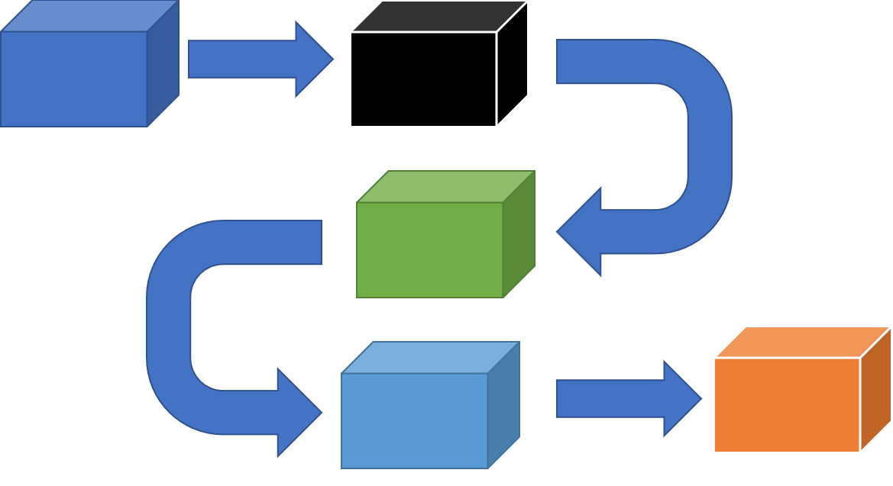


Why Ply
End to End API Testing
No Code Testing
Documentation
Load Testing
Graphical API flow builder
Chain the APIs without writing code
RegEx support for dynamic values
Graphical Side-by-side results
Auto-generate result files
VS Code extension
CLI
Parameterize values
Augment OpenAPI doc with realistic requests/responses Generate code snippets in TypeScript, Python and Java
Large datasets using csv files
Ability to do parallel execution
01
02
03
04

Slide 4
Ply Comparison
Functions | Ply | Postman | ReadyAPI | SOAtest
Graphical Flows | ✓ | ✗ | ✗ | ✗
Side-by-Side Results | ✓ | ✗ | ✗ | ✗
Codeless Testing | ✓ | ✗ | ✗ | ✗
Auto-Generate Results | ✓ | ✗ | ✗ | ✗
GraphQL Support | ✓ | ✓ | ✓ | ✗
Dynamic Input Values | ✓ | ✓ | ✓ | ✓
Previous Response Refs | ✓ | ✓ | ✓ | ✓
Open Source | ✓ | ✗ | ✓ | ✗
VS Code Extension | ✓ | ✗ | ✗ | ✗
CI/CD Embeddable | ✓ | ✓ | ✗ | ✓

Slide 5
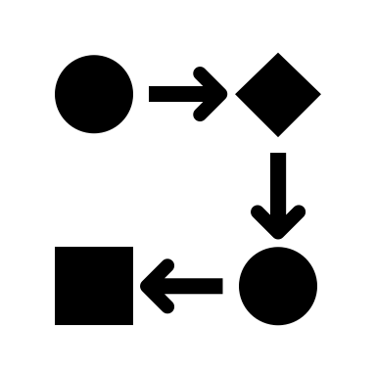



Ply Steps
Create API Flow
1
Graphical editor
Orchestrate APIs
Generate expected file & parameterize
2
Auto generate result file & Use regex
Reference previous results in a downstream step
Run
3
Single API
Multiple APIs
Compare Results
4
Graphical side by side diff editor
Integrate with CI/CD
5
Execute test cases during build

Slide 6
Public Sector Quality Control Matrices
Test Cases
Code Coverage
API Endpoints
84
428
80%
UI Reuse
Code Snippet
SonarCube Int
Documentation
Auto Gen Samples
CI/CD Integration
API Docs
Import from Postman
DevOps
ScoreCard

Slide 7
Links to Resources
01
04
Ply
DevOps Scorecard
02
05
Gov API Center
Visual Studio
03
06
Dev Practices Docs
Ply Github

Slide 8

8

Slide 9
Q & A
9

Slide 10
Rest of the Year Priorities

Slide 11
Appendix
11

Slide 12



API Resources
Ply
Gov API Center
Customer
Ply Documentation
PS Quality Assurance
API Best Practices

Slide 13
What problems Ply solves (delete – Next slide)
End to End API Testing
Graphical API flow builder
No Code Testing
Graphical Side-by-side results
Documentation
Use the output from one API as input to next API without writing code
Auto-generate result files by capturing actual good responses
RegEx support for dynamic values
Parameterize values
Test Case help Augment OpenAPI specs
Realistic requests/responses from Test cases
CLI, VS Code extension
Adds code snippets in TypeScript, Python and Java
Load Testing
large datasets using csv files
Ability to do parallel execution

Slide 14
Create Tests
Quickly Crete Meaningful End-to-End Test Cases
A test is created for each operation, which can then be chained into functional testing scenarios
Quickly Generate default result files
Use Regular Expressions for Dynamic input values
Refer to previous Response Refs
Create Load Test using Spread Sheet
Ability to create test Orchestration
Ply supports embedding test flow logic into your test scenarios, enabling complex test flows without complex scripting.
Collaborate using Git

Slide 15
Run Tests
Run and Record
Single API or multiple APIs
Load test: Single threaded or Multi Threaded
Generate Test Cases for API documentation

Slide 16
Verify Test Results
Graphical side by side diff editor
Quick visibility in Code Coverage
SonarQube Integration
Easy to integrate with CI/CD
Generate sample Test Case for API documentation

